Slide 1

Capstone Project Instructions
Carol Sikler
March 7, 2007
Objective:
The Agricultural and Biological Engineering Department offers an annual Senior Capstone Project competition concurrent with the ABE Outstanding Alumni and Outstanding Service Awards. As a service of the department, I am available to print your PowerPoint presentations on our poster printer. If you will be using a program other than PowerPoint, please be sure to check with me prior to the deadline so that printing problems can be avoided (not all software packages are supported). You are not required to submit your project through me if you do not want it printed on the poster printer. A template is available on diskette or can be downloaded at: https://engineering.purdue.edu/ABE/InfoFor/CurrentStudents/SeniorProjects/2008/index_html (*Note* - It is near the bottom of the page). Projects may be submitted via email (sikler@purdue.edu), on CD-ROM, or jump drive. The deadline is Monday, April 20, 2009. Check with your professor for other instructions.
Carol Sikler
ABE 208, 494-8162
Design and printing instructions:
Maximum of three panels - please do not change the dimensions on the File/Page Setup menu. Finished panels must be 31" x 44" or smaller to fit on the corkboards. The page size is set as the paper size. The light blue border must not be moved or changed - this represents the actual dimensions of the finished panel (you must work within the boundaries). (Warning: if your template does not have a light blue outline around each slide, you are using an OLD version! Be sure to download the latest PowerPoint file from https://engineering.purdue.edu/ABE/Undergrad/).
Text on the template can be highlighted and replaced – avoid the use of too many different fonts. The printer does not support all of the fonts that some of the other printers do and could result in unreadable text (i.e., fonts that are named “Technical”). It is best to use a 40 point font or larger (this text box is in 40 point font).
The text boxes on the template are suggested placements only – they can be moved and changed (color, line thickness, etc) as necessary.
Please realize that the use of background color slows the printer dramatically, as well as diminishing the supplies more rapidly (in other words – expen$ive) - not to mention that it makes the paper wrinkle. Please be judicious in your use of background color. AutoCAD drawings need to have the black background changed prior to inserting (Under “Tools,” “Options,” “Display” click on the background and select a different color – preferably white or something else VERY light).
Title. Name(s) again here. ABE, ASM, or FBPE
Month Day, Year

Slide 2
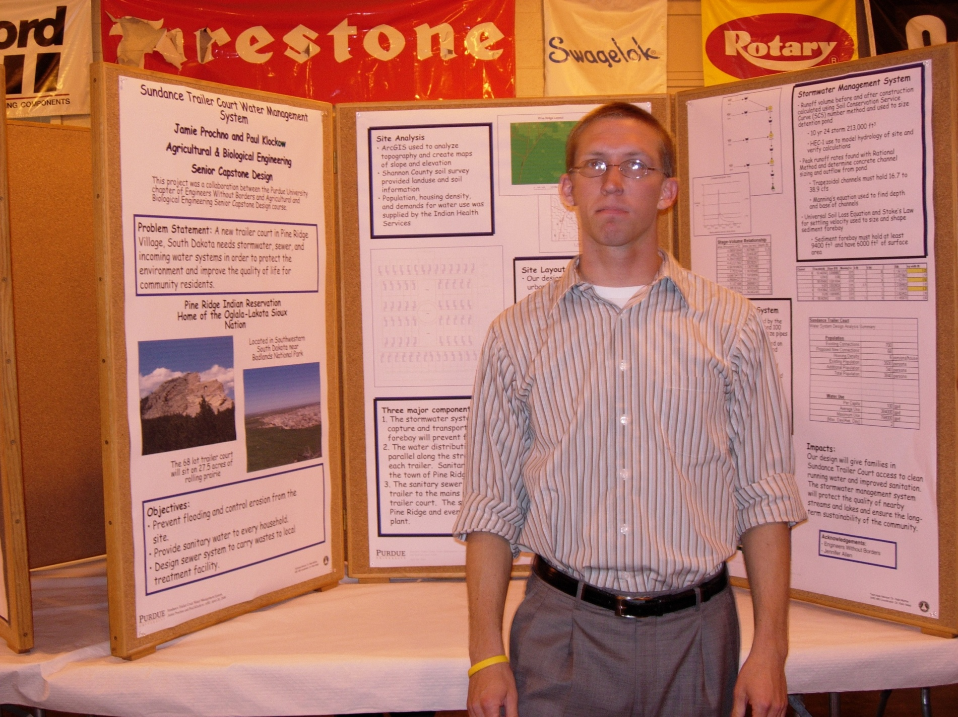

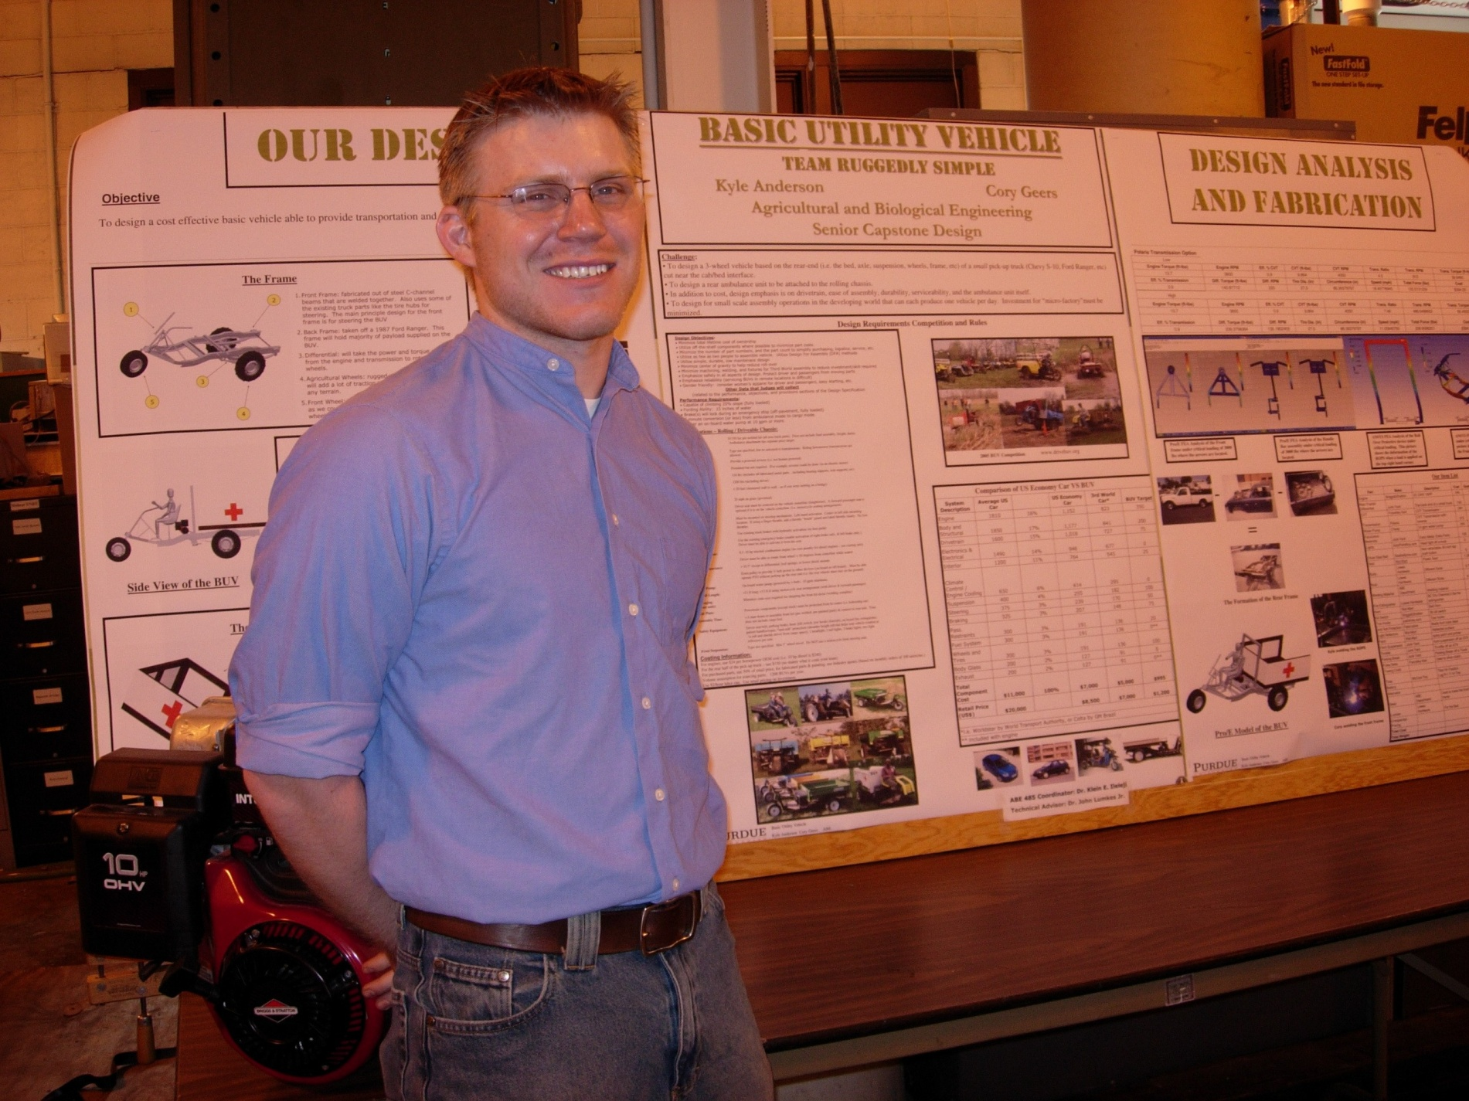
The deadline for submitting your project is a firm deadline, independent of other activities you may be participating in outside the department. There are three groups printing projects and late submissions will be queued behind the other classes and printed on an as-available basis. Our new printer is much more efficient; thus, the deadline extension to Monday.
Please print a scaled-down version of your project to the color printer ABE208H1 or ABE201H1 and have it signed by your advisor prior to submitting it to me for printing (to check for spacing, perspective, etc.). You can choose “Scale to fit paper” in the print dialogue box. Ask me (48162 or sikler@purdue.edu) if you have any questions. Please bring me a copy of the scaled version with your instructor’s signature on it as “approved.” I will be delighted to print projects once I have the signed version.
Do not try to print your own job on the department poster printer. The risk is very high that your job will be deleted from the queue.
If you leave an email address with me when you submit your project to be printed, I will notify you when your project has been trimmed and is ready to be checked. I have a place to store the completed projects in my office.
Team member and program names (ANRE, ASM, BFPE) must be on the panels, either in the title box or in the “credits” box at the bottom left-hand corner of the first panel. Repeating the “credits” box on each panel is not required, but is helpful when sorting the panels. (Hint: my name is in that box – if you don’t change it, I get credit for your work…)
These blank spots are always a good place for clip art, photographs, diagrams, etc
Helpful hints on graphics: any item that is “borrowed” off the Internet is going to be at a low (72 dpi) resolution. Increasing the size does not increase the resolution – it just makes the pixels appear bigger. Check your graphics at 100% on-screen to make sure they are clear. When possible, save in the .jpg format. Some of the poster files are enormous due to a large number of .tif or .bmp pictures – this can present problems when it is time to print.
Title Name(s). ABE, ASM, or FBPE
Month Day, Year

Slide 3
Presentation and award instructions:
The projects will be displayed in room 106 on April 23 for judging. Set-up will begin that morning. Corkboards and thumbtacks will be provided for your use. Notify Scott Brand (41218, brand@purdue.edu) if you will need extra table space or a power supply for your display. Please, no pushpins.
Projects should be fully set up by noon. Judging begins at 1:30 p.m. At least one team member must remain with the project to answer questions. There are separate judges for each of the disciplines.
Prizewinners will be determined by the judges and their decisions are final. A sample of the judging form is attached. Prizes will be awarded to the top two projects in each discipline (BFPE, ABE, ASM) at the ABE Spring Celebration Banquet. Winners should see the ABE Business Office account clerk, Kathy Moore, after the event to arrange to receive your check.
Winning projects will be transported to the University Inn by the department. All participants who can attend the celebration that evening (poster viewing at 5:30 p.m., dinner at 6:00 p.m.) are urged to do so. ABE student cost is $5.00 and you can sign up with Micky Creech or Yvonne Hardebeck in ABE 201.
If you have any questions about set-up, awards, or the banquet, please contact Micky Creech at 41213 (mcreech@purdue.edu).
And now you can go rest, because not only have you finished your project, you finished it early and have already turned it in to Carol to be printed. Your eyelids are getting veeeeery heavy…
Title. Name(s). Program (ABE, ASM, FBPE)
Month Day, Year

